Slide 1

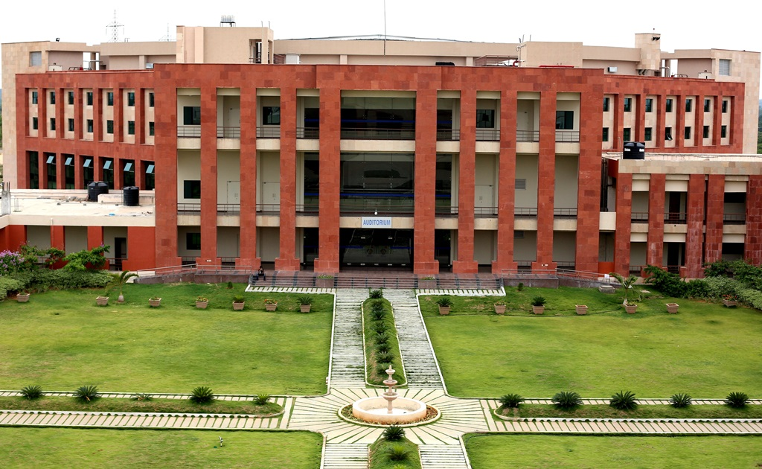
Principles of Programming Languages
(CS F301)
Jabez Christopher
Assistant Professor
Department of CSIS

Slide 2
Formal Methods of Describing Syntax
Regular Expression
BNF
EBNF
Attribute grammar (Syntax & STATIC SEMANTICS)
DYNAMIC SEMANTICS
Operational Semantics
Denotational Semantics
Axiomatic Semantics

Slide 3
Axiomatic Semantics
Based on mathematical logic
Precondition: An assertion that immediately precedes a program statement and describes the constraints on the program variables.
Postcondition: An assertion that follows a statement and describes the new constraints on those variables (and possibly others) after execution of the statement.
Weakest precondition: the least restrictive precondition that will guarantee the validity of the associated postcondition.

Slide 4
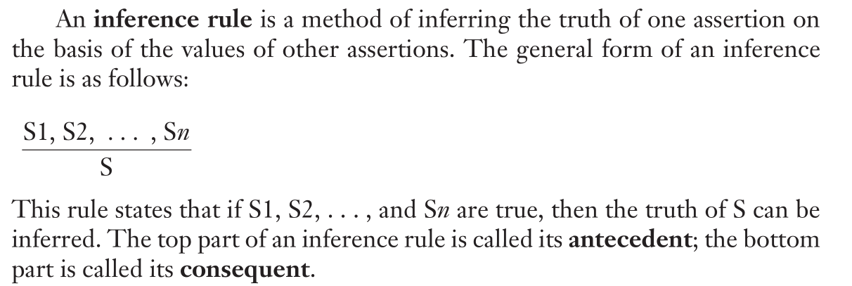
Axiomatic Semantics

Slide 5
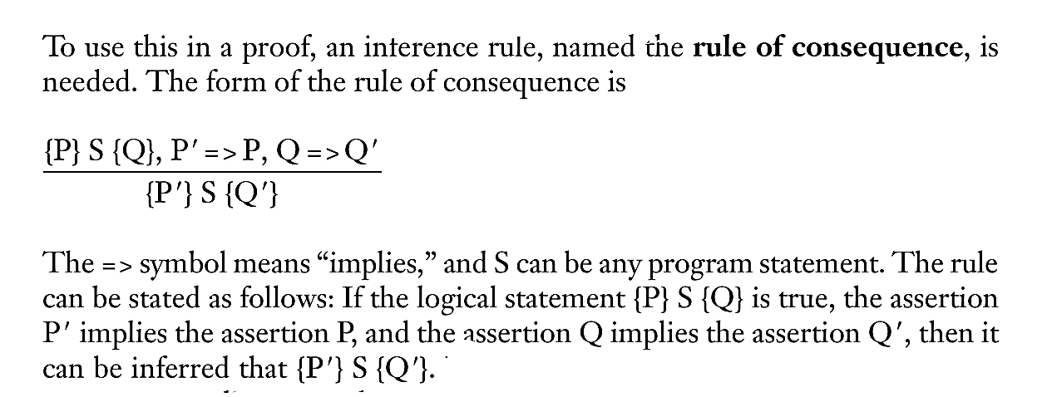
Axiomatic Semantics

Slide 6
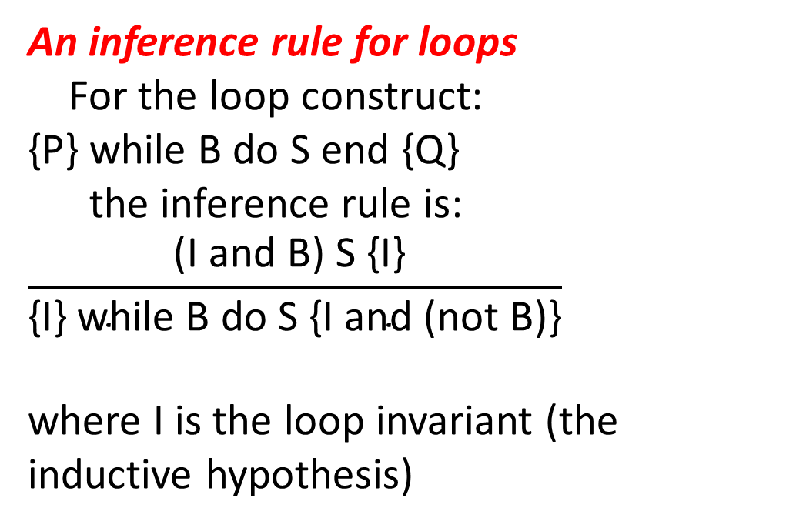
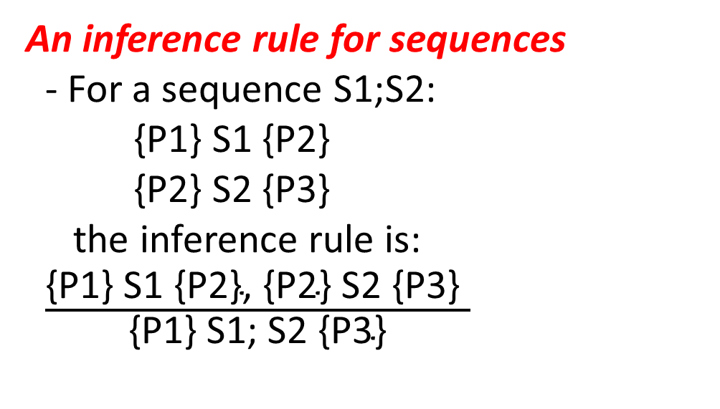
Axiomatic Semantics
An inference rule for sequences
- For a sequence S1;S2:
{P1} S1 {P2}
{P2} S2 {P3}
the inference rule is:
$\frac{\text{\{}\text{P}\text{1\} }\text{S}\text{1 \{}\text{P}\text{2\}, \{}\text{P}\text{2\} }\text{S}\text{2 \{}\text{P}\text{3\} }}{\text{\{}\text{P}\text{1\} }\text{S}\text{1; }\text{S}\text{2 \{}\text{P}\text{3\}}}$
An inference rule for loops
For the loop construct:
{P} while B do S end {Q}
the inference rule is:
$$\frac{\text{(}\text{I} \text{and} \text{B}\text{) }\text{S}\text{ \{}\text{I}\text{\} }}{\text{\{}\text{I}\text{\} }\text{while} \text{B} \text{do} \text{S}\text{ \{}\text{I} \text{and}\text{ (}\text{not} \text{B}\text{)\}}}$$
where I is the loop invariant (the inductive hypothesis)

Slide 7
Axiomatic Semantics: Loops
Invariant (I) must meet the following conditions:
1. P => I (the loop invariant must be true initially)
2. {I} B {I} (evaluation of the Boolean must not change the validity of I)
3. {I and B} S {I} (I is not changed by executing the body of the loop)
4. (I and (not B)) => Q (if I is true and B is false, Q is implied)
5. The loop terminates (this can be difficult to prove)

